Slide 1
2015 Quality Judging Classes
State FFA Horticulture CDE

Slide 2
A P P L E S
Class 1

Slide 3
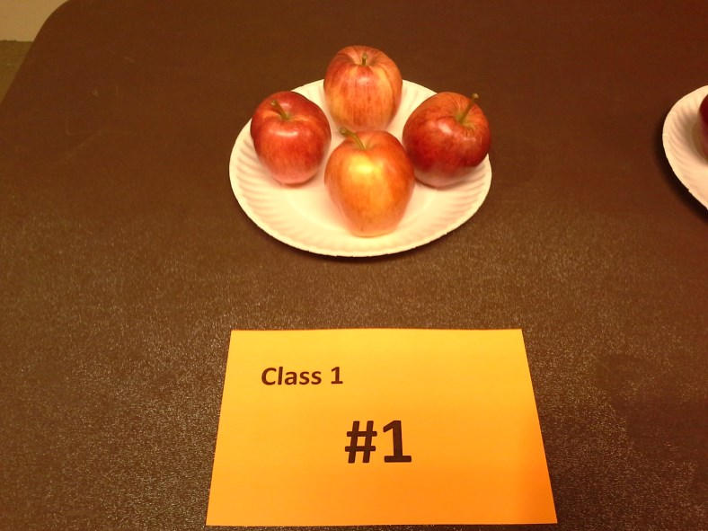

Slide 4
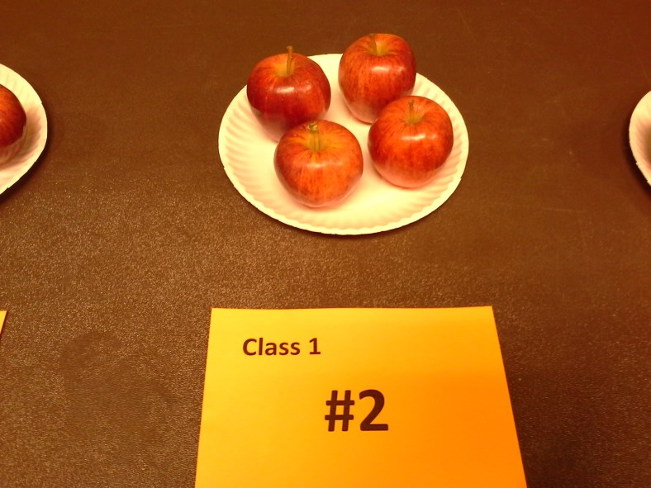

Slide 5
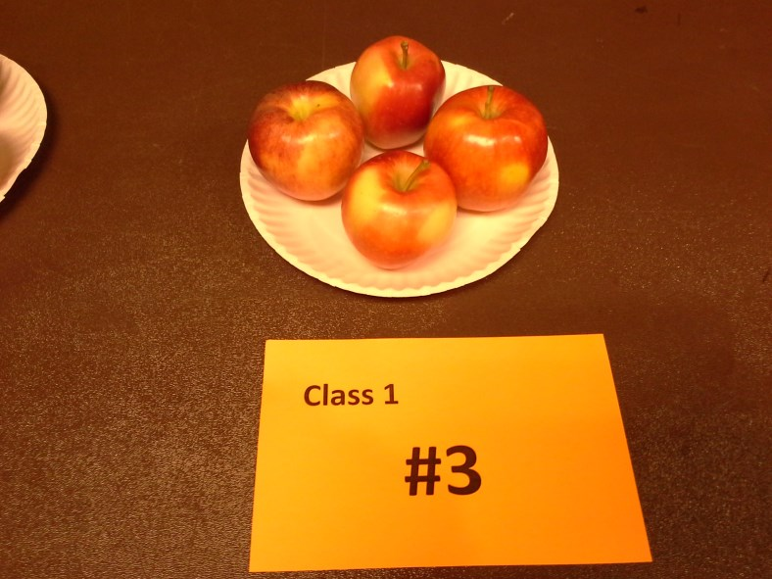

Slide 6
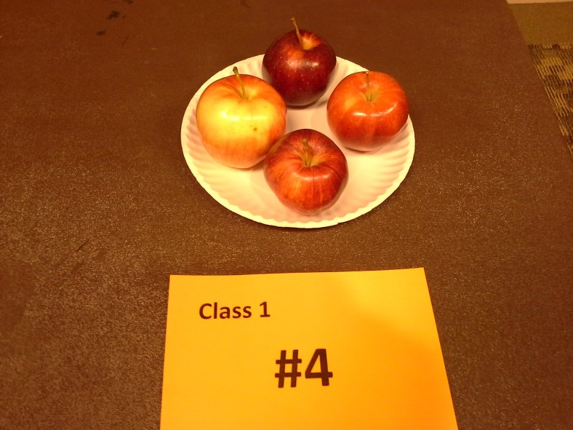

Slide 7
1
2
3
4
These apples had cuts and bruises on them.

Slide 8
P O T A T O E S
Class 2

Slide 9
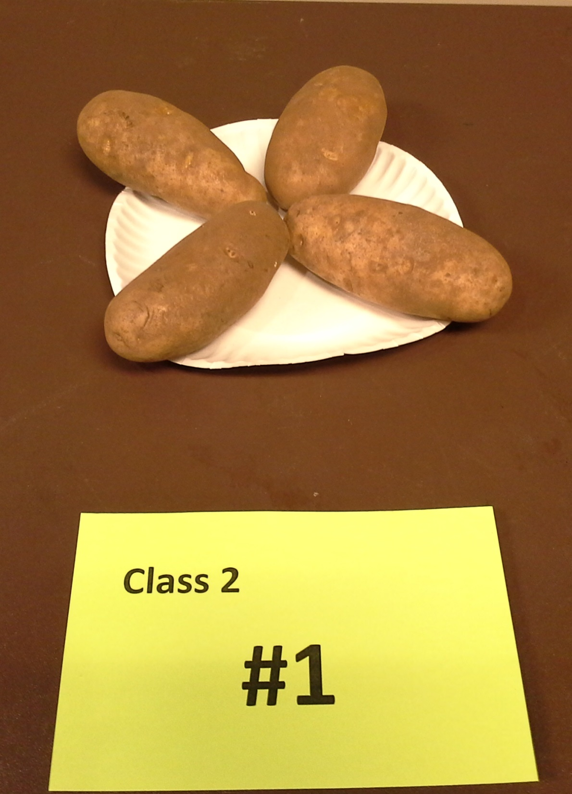

Slide 10
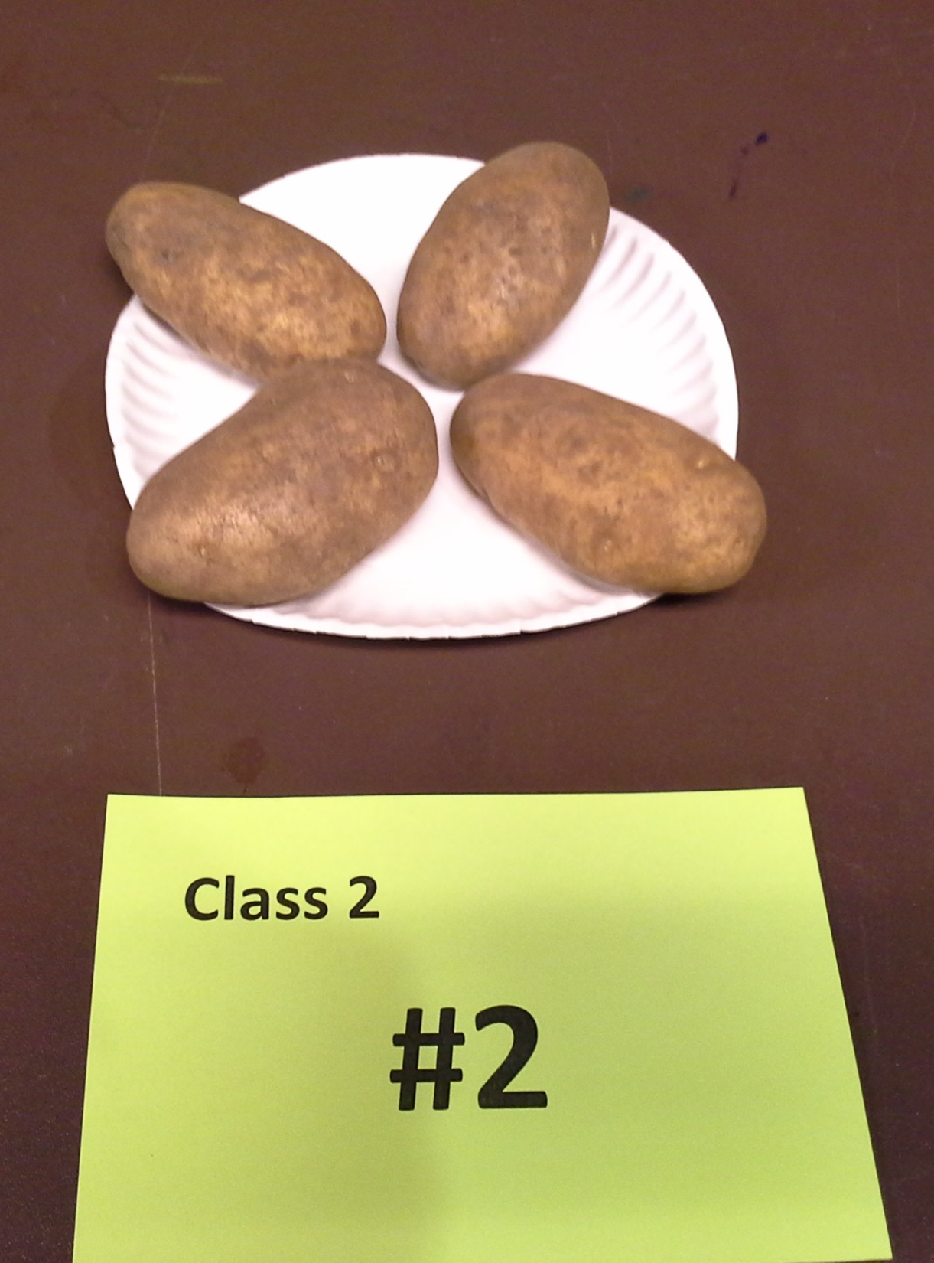

Slide 11
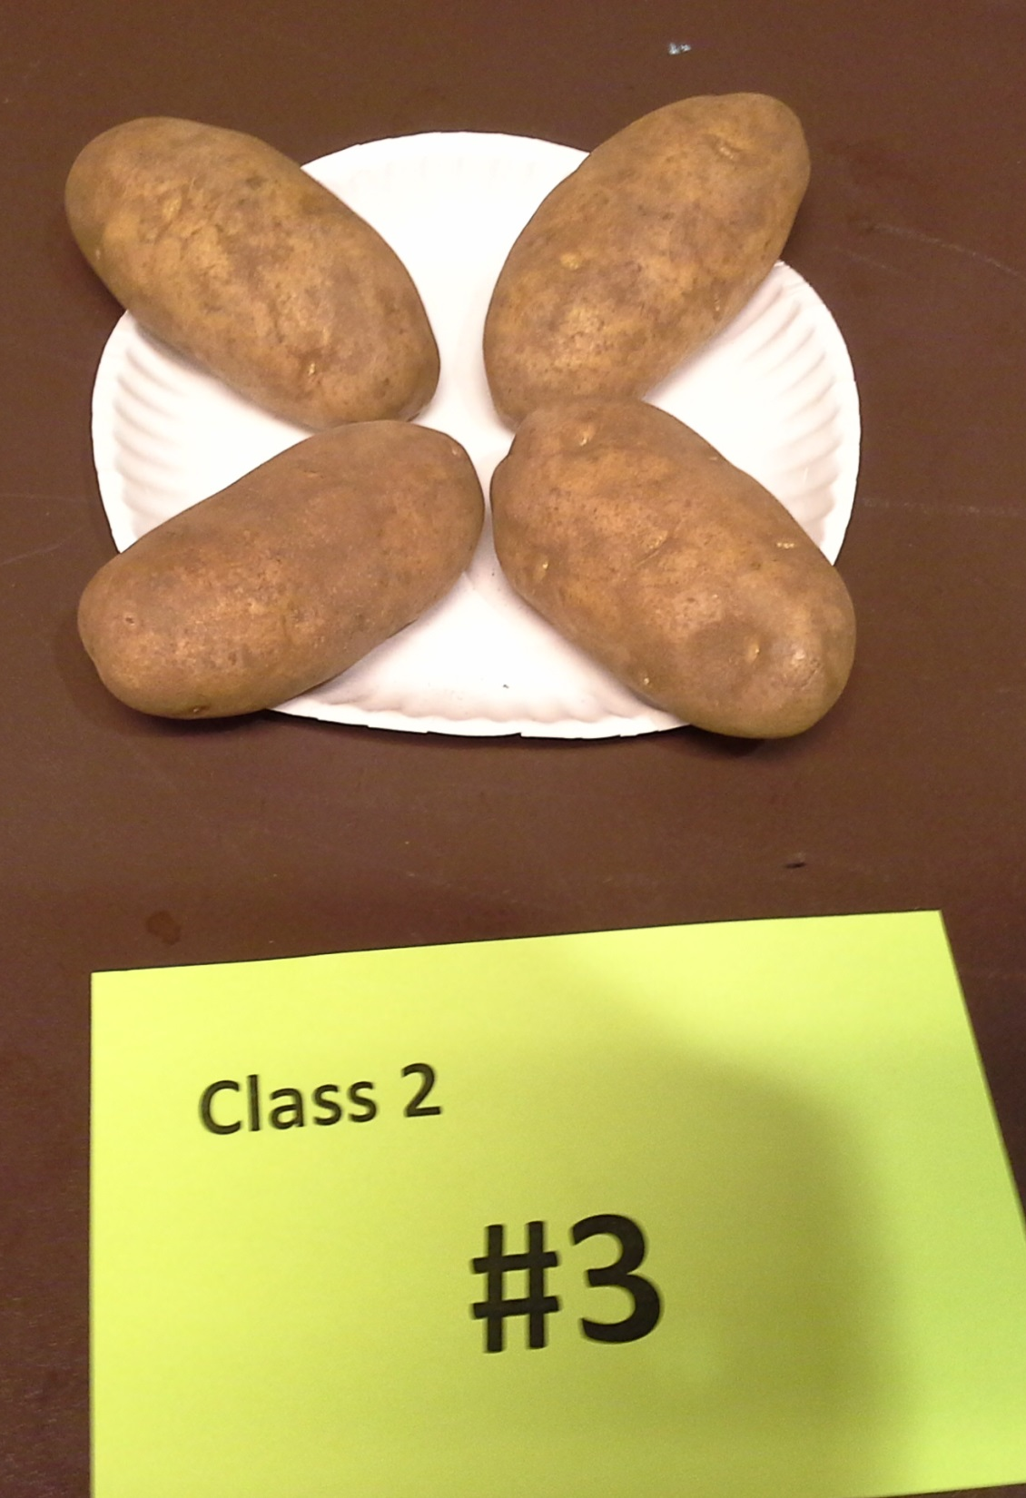

Slide 12
10.

Slide 13
1
2
3
4

